Slide 1
GUI Application development with Eclipse

Slide 2
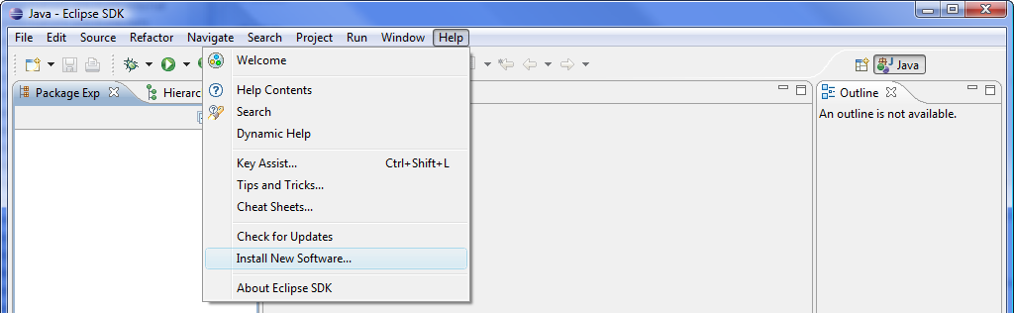
How to Add Window Builder Software to Eclipse
Select "Help > Install New Software..." in the main menu to open the "Install" dialog

Slide 3
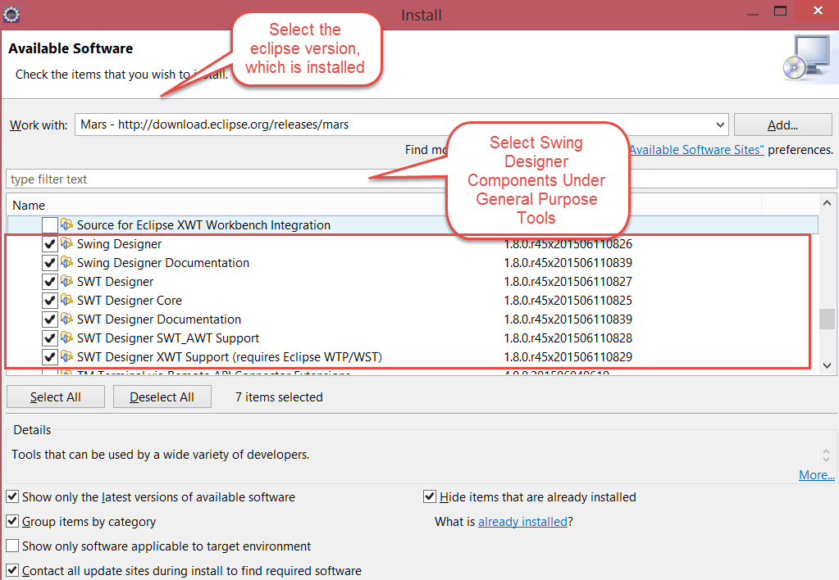

Slide 4
Click on Next → Next → Accept the agreement → Finish
Restart the Eclipse

Slide 5
How to create a GUI application in Eclipse
Right click on Project
Click on New
Click on Others
Select Window Builder
Select Swing Designer
Select Application Window/Jframe Form etc.
Enter Class Name
Finish
Select the Design or Source
Do the Programming

Slide 6
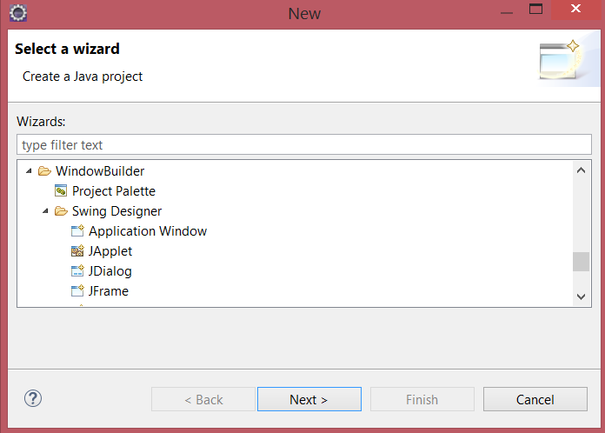

Slide 7
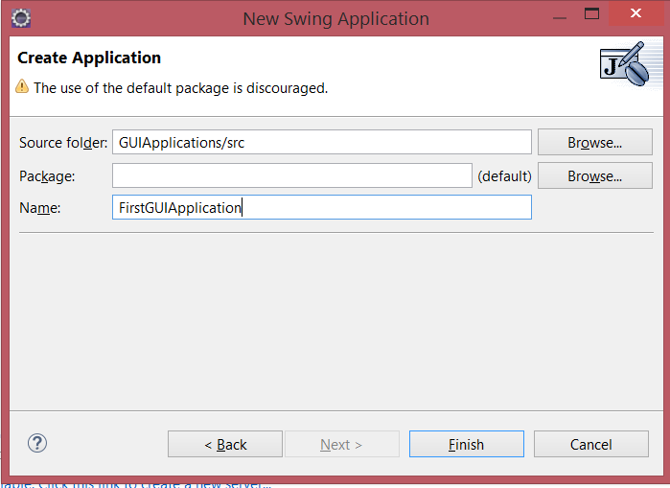

Slide 8
